Slide 1

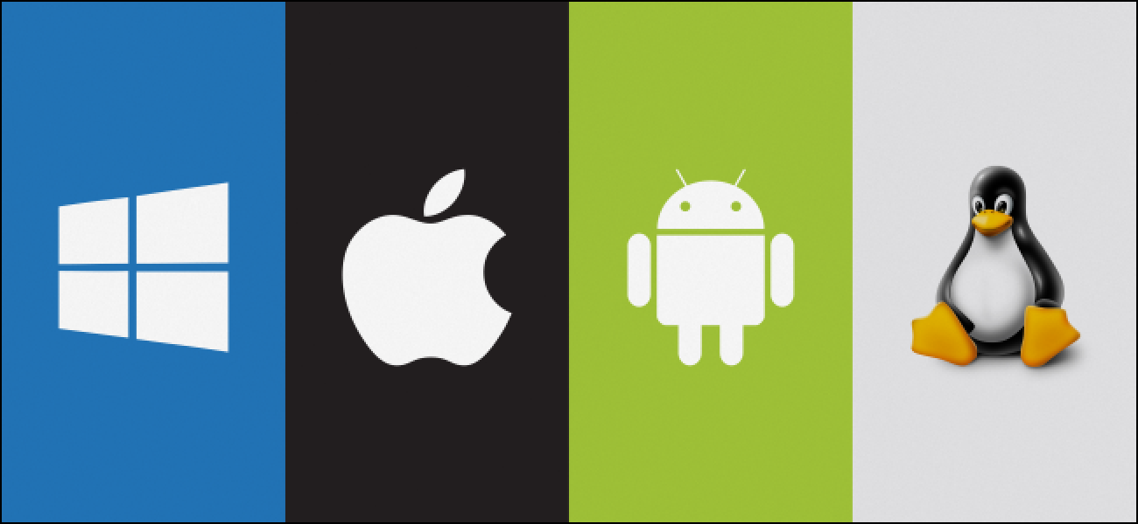
Operating systems
Student group: IU5-42B
Student: Kudabayeva Evita

Slide 2
Contents:
- Definition of OS
- Structure of an OS
- Types of OS
- Functions of an OS
- History of OS (Key moments and breakthroughs)
- Advantages and Disadvantages
- Future development trends
- Conclusion
- Sources

Slide 3
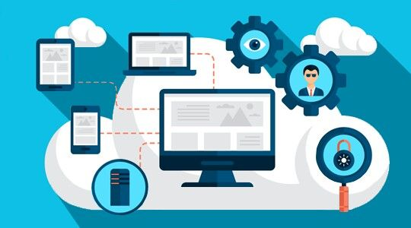
Definition
An operating system is system software that manages computer hardware and software resources, providing common services for computer programs.
(*) It acts as an intermediary between users and the computer hardware, facilitating the execution of all programs.

Slide 4
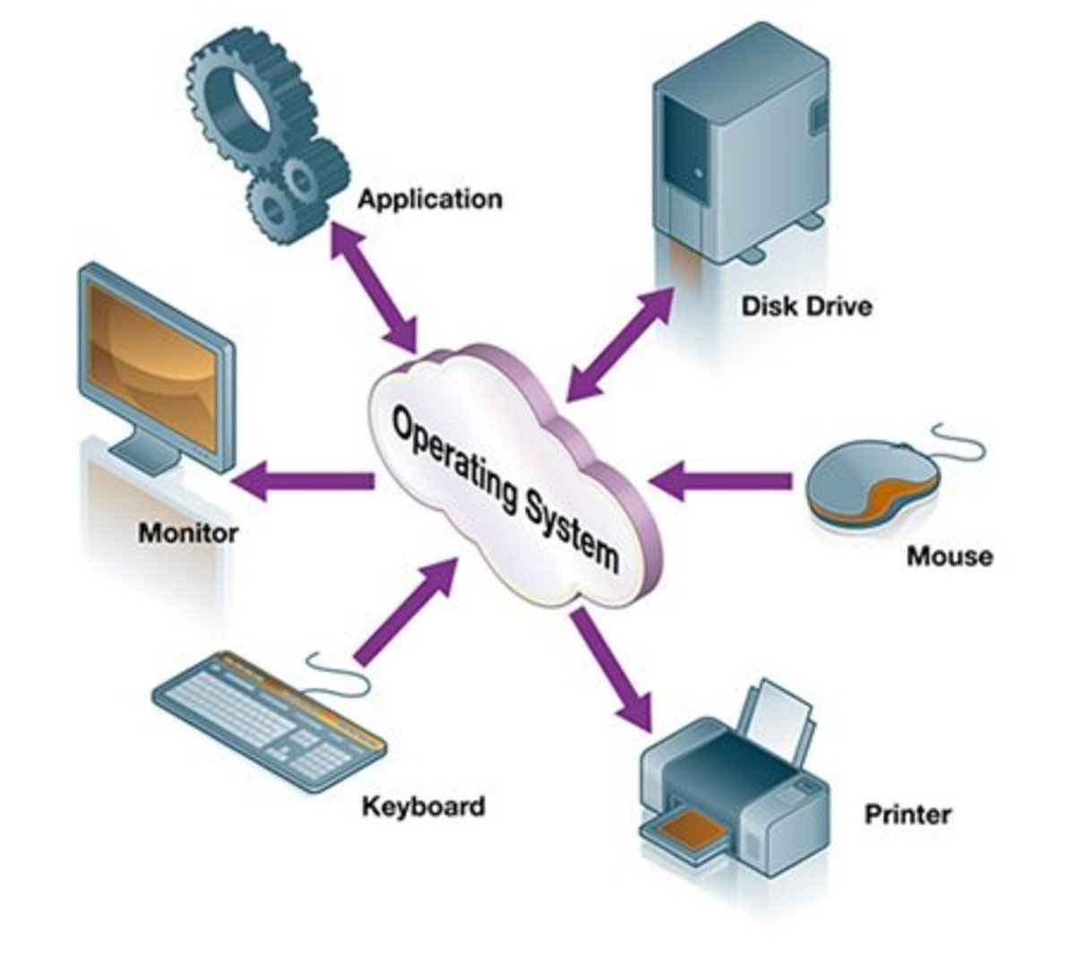
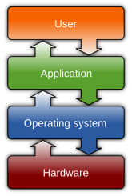
Structure (Basic mechanisms)

Slide 5
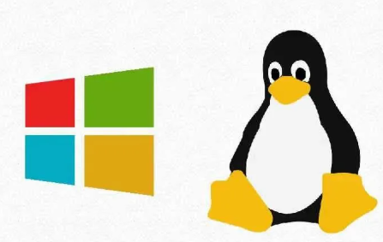
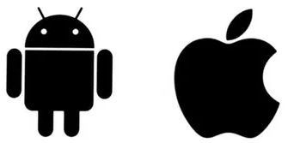
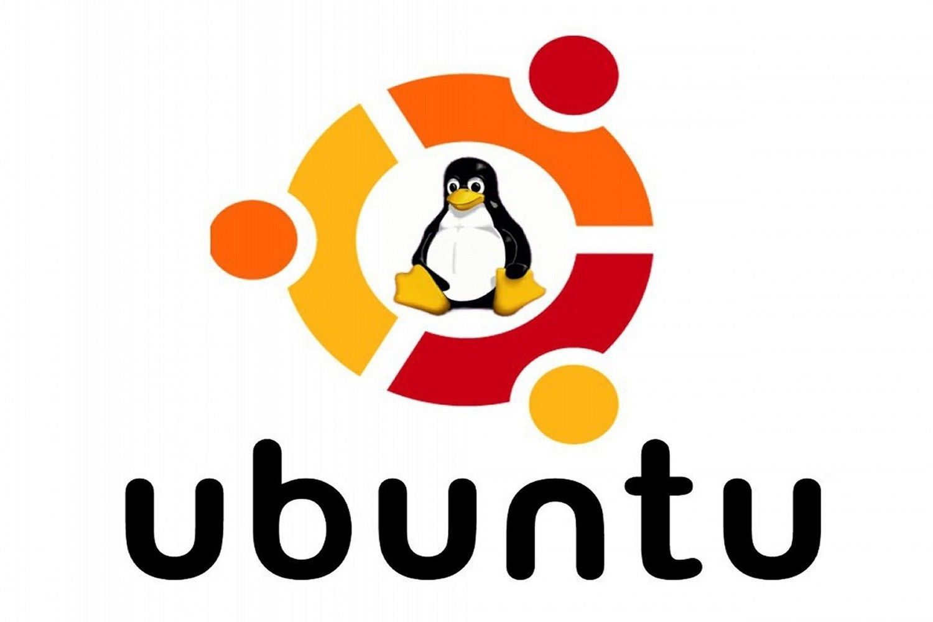
Types
Operating systems can be categorized based on their functionalities and applications:
1
Desktop OS
Windows – Most widely used, user-friendly.
macOS – Exclusive to Apple devices, optimized for stability.
Linux – Open-source, customizable, and used in development environments.
2
2. Mobile OS
Android – Open-source, used in most smartphones.
iOS – Apple’s exclusive mobile OS, known for security.
3
3. Server OS
Windows Server – Enterprise-level networking and management.
Linux (Ubuntu, Red Hat, Debian) – Secure, preferred for hosting services.

Slide 6
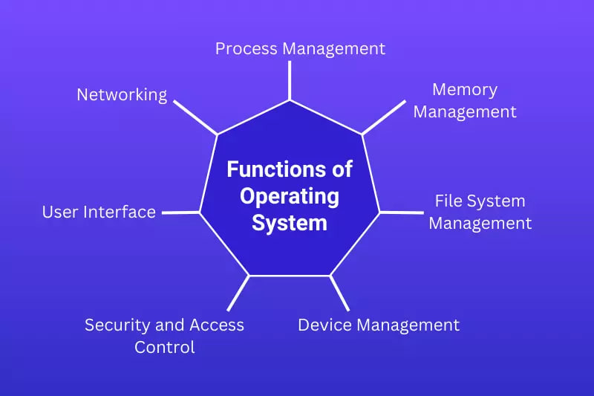
Functions

Slide 7
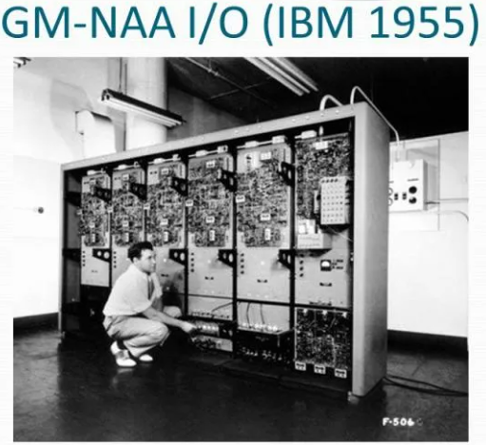
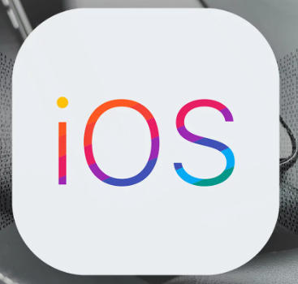

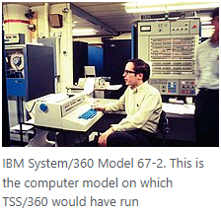
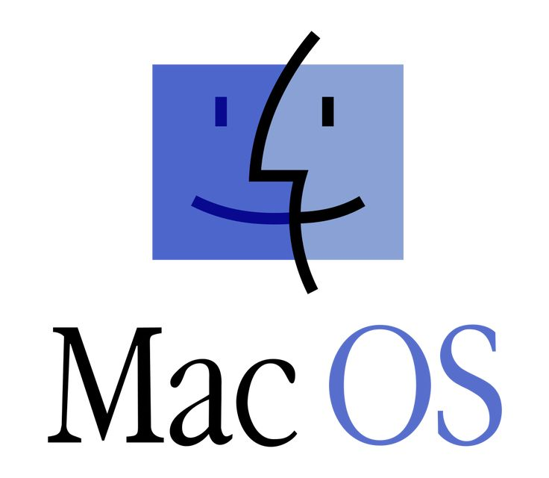

History
1950s – Early batch processing systems for large computers.
1960s-1970s – Unix developed, introducing multi-user environments.
1980s – Personal computers rise, MS-DOS and macOS emerge.
1990s – Windows dominates, Linux gains popularity.
2000s-Present – Mobile OS (Android, iOS) revolutionize computing, cloud-based systems grow.

Slide 8
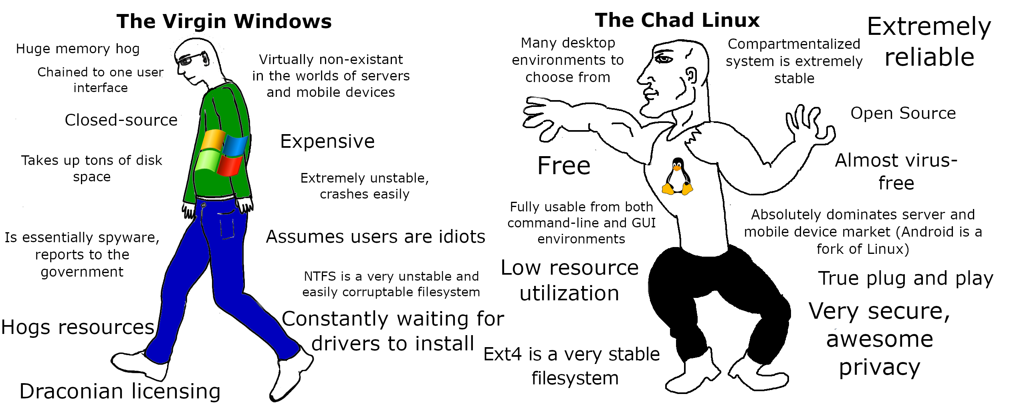
Advantages and disadvantages
Advantages:
Disadvantages:
✅ Provides a user-friendly interface. ✅ Efficient resource management. ✅ Enhances security through access
control. ✅ Supports multitasking.
❌ Vulnerable to viruses and cyber
threats (Windows). ❌ Some OS are expensive (macOS). ❌ Compatibility issues between different
operating systems.

Slide 9
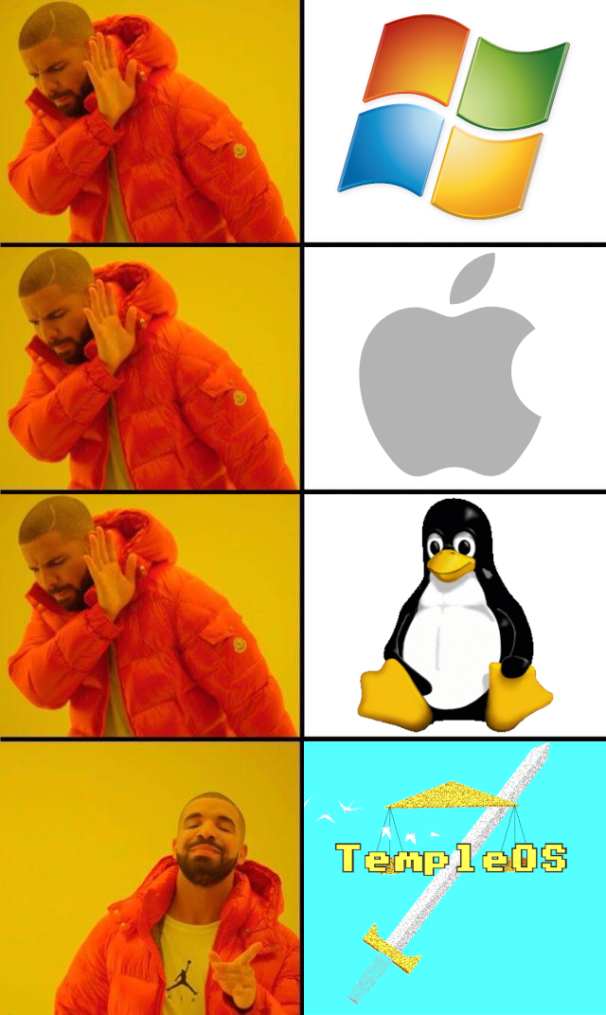



Future development trends
🔹 AI-Integrated OS – Smart automation, personalized
user experience.
🔹 Quantum Computing OS – Advanced computing
power management.
🔹 Cloud-Based OS – Enhanced remote access
and data storage.
🔹 Security Enhancements – More sophisticated
threat detection.
4

Slide 10
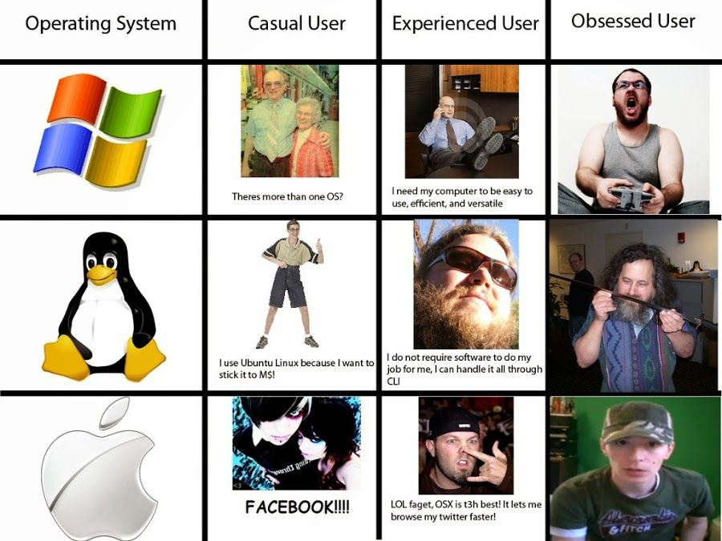
Conclusion
Operating systems are essential for managing computing resources and providing a seamless user experience.
Their evolution continues with new technologies, improving efficiency, security, and usability.

Slide 11


Slide 12
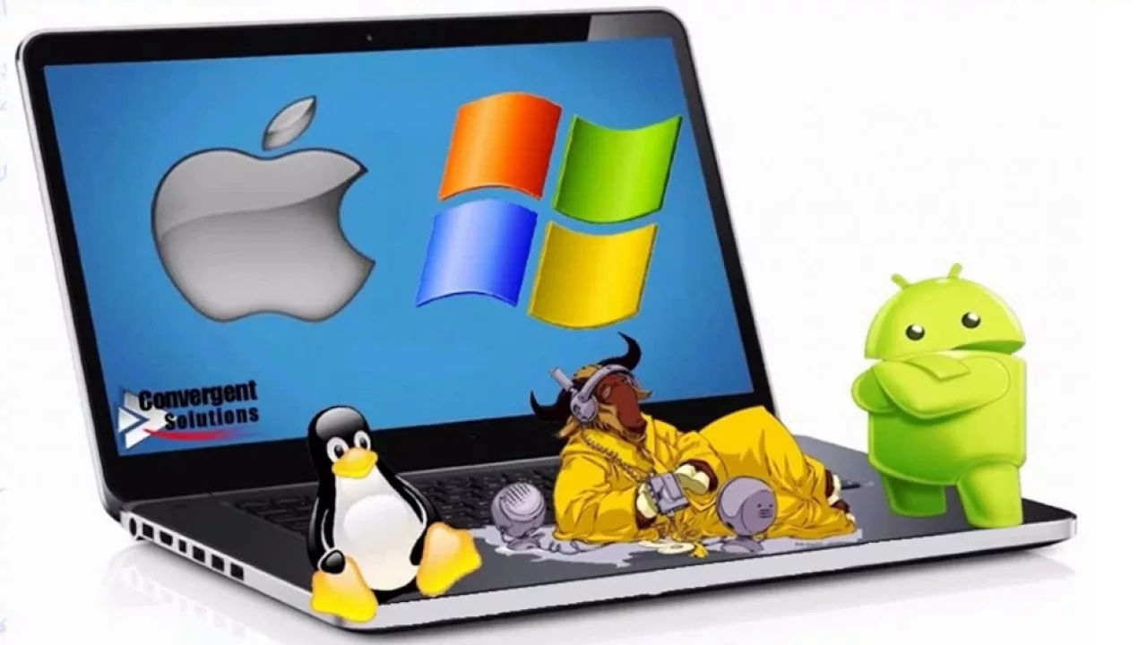
Sources:
Tanenbaum A.S. – Modern Operating Systems;
Official OS documentation (Microsoft, Apple, Linux);
Operating Systems: Three Easy Pieces
Operating system - Wikipedia

